Slide 1
Name: Muhammad Zaeem Altaf Contact : 0345 2793244 Email : official.zaeemaltaf@gmail.com Website: https://vaultsneaks.vercel.app/
Welcome to Our website:

Slide 2

Problem Statement: 1.Sneaker enthusiasts often struggle to find a reliable source for the latest and trendiest sneakers. 2.Lack of a personalized shopping experience for sneaker collectors and fashion-forward customers.
Solution
VaultSneaks offers a curated selection of the latest sneakers with a focus on exclusivity and style.
Personalized user experiences with recommendations based on browsing history and preferences.

Slide 3
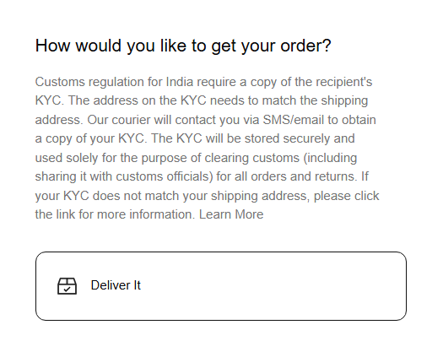
Business Model:
Revenue Streams:
Direct sales from the website.
Premium memberships for early access to limited-edition releases.
Pricing Strategy:
Competitive pricing with options for premium memberships and limited-edition collections.

Slide 4
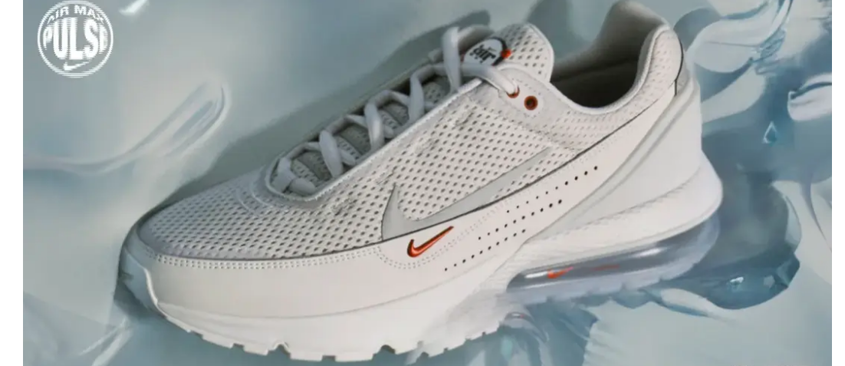
HOME PAGE:

Slide 5
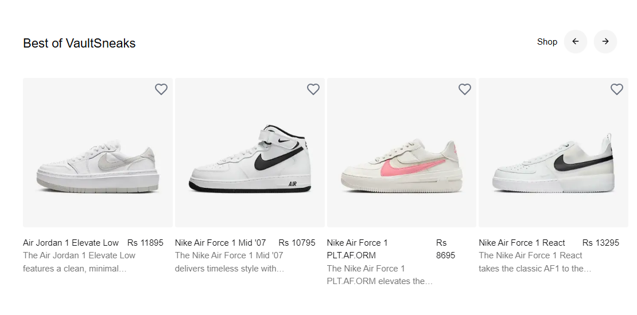
PRODUCTS:

Slide 6
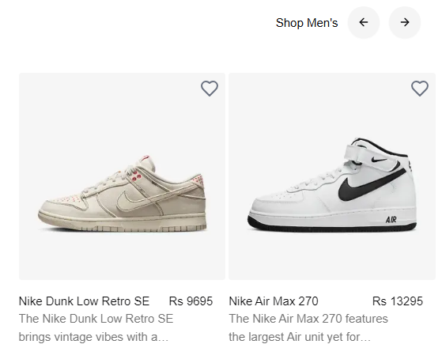
Product/Service Overview
Key Features:
Extensive product catalog of men's and women's sneakers.
User-friendly interface with a seamless shopping experience.
Features like wishlists, reviews, and personalized recommendations.

Slide 7
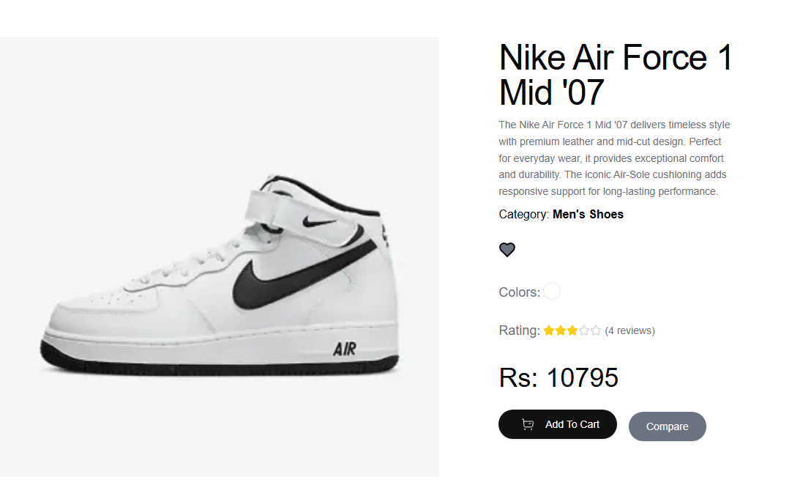
Product Detail

Slide 8
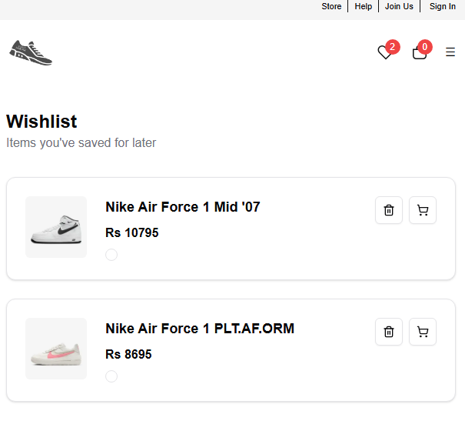
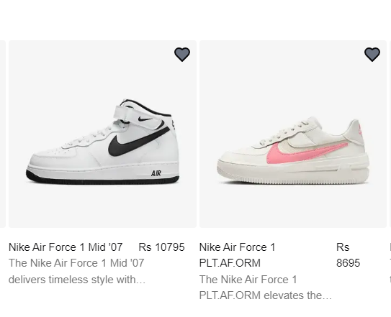
Wishlist

Slide 9
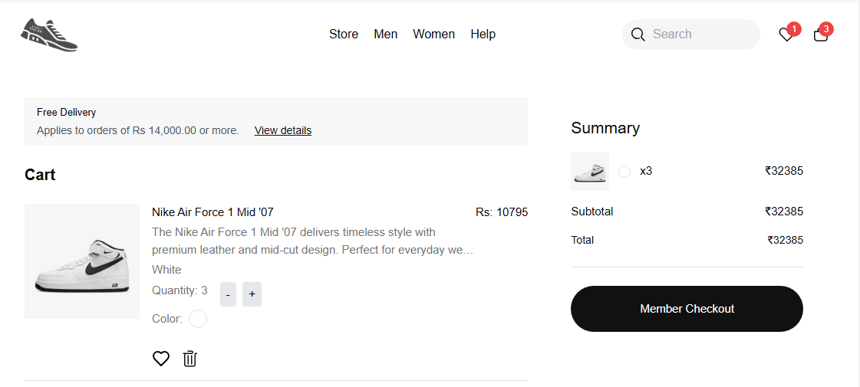
Add To Cart

Slide 10
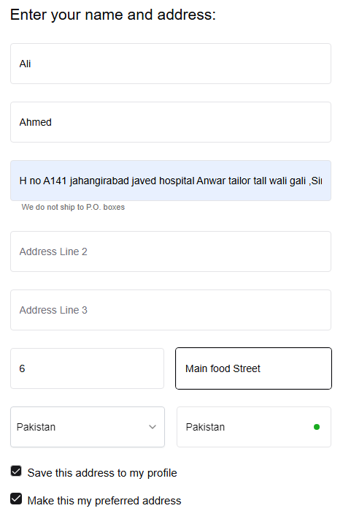
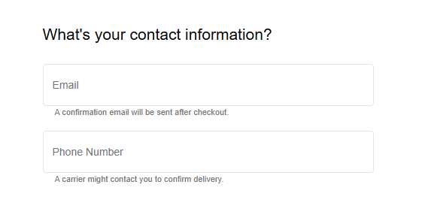
Contact Us:

Slide 11
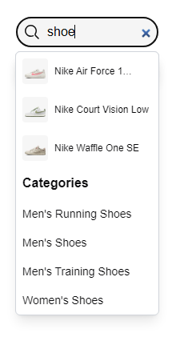
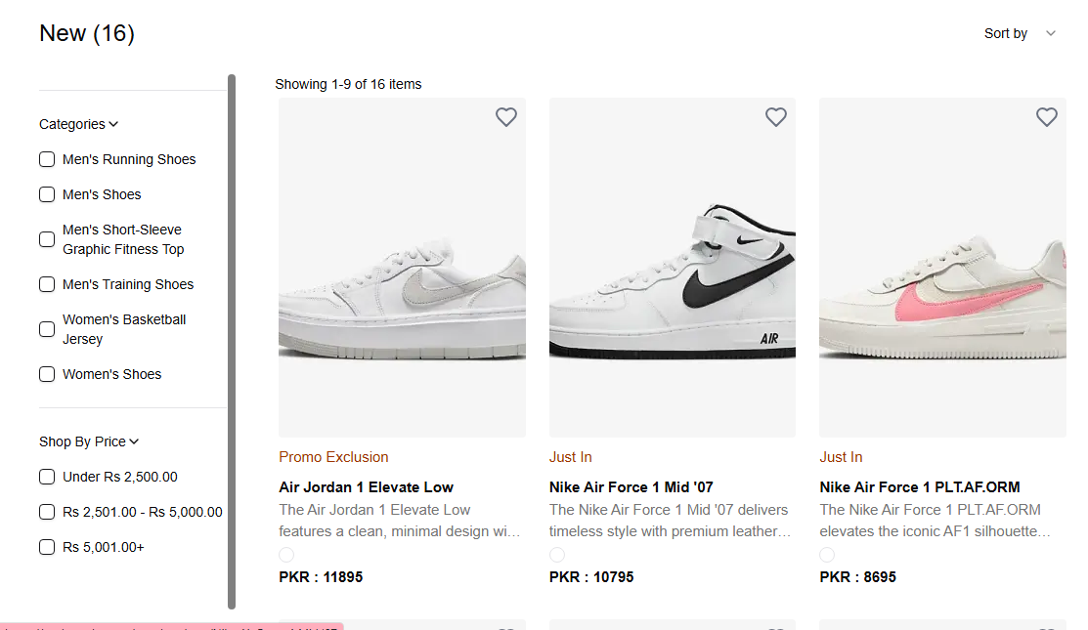
Search Bar:

Slide 12
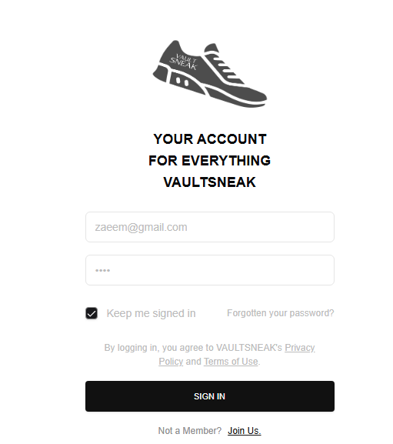
Login Page

Slide 13
Marketing and Sales Strategy:
Customer Acquisition Channels:
Social media marketing (Instagram, TikTok)
Influencer partnerships and collaborations
SEO and content marketing strategies

Slide 14
Thank you for considering VaultSneaks:
Contact : 0345 2793244
Roll no: 00352763
Portfolio link: muhammadzaeemaltaf.vercel.app
Email : official.zaeemaltaf@gmail.com
Website: https://vaultsneaks.vercel.app/
“Join us in stepping into the future of sneaker fashion."

